Slide 1

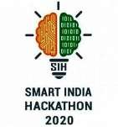



SIH 2020
Govt. of Bihar (DOA)
Project: Develop a Real time land usage monitoring tool using satellite data and AI.
Team : Central Crew
College: Maharaja Surajmal
Institute of Technology, New Delhi

Slide 2
From the understanding of Problem Statement, we decided to build a model to predict the yield amount of a specific crop for the provided state and further district given by the user.
DAY 1
To tackle this problem, we have planned to build an android application and website termed as FarmAid

Slide 3
Idea/Solution:-
FarmAid is an application targeted towards the admin officials of Dept. of Agriculture aiming to improve the current condition of Indian farmers by helping them plan their agricultural year. Crop production is mostly influenced by various agricultural as well as climatic factors which can be studied through satellite data made available by ISRO We pre-processed and wrangled the already available data given on the government site: https://aps.dac.gov.in/APY/Public_Report1.aspx where the data in the form of image is converted into NDVI of numeric form.

Slide 4
Technology Slack :
Data
ML/AI
MACHINE LEARNING/AI:
ARIMA Model for Time Series Forecasting
Keras Regression Model
Pickle for saving and loading Models
Flask for Deploying API to Heroku
Android
Website
ANDROID:
Android Studio
Firebase
Retrofit
Dialogflow kit
WEBSITE:
HTML/CSS
Bootstrap

Slide 5
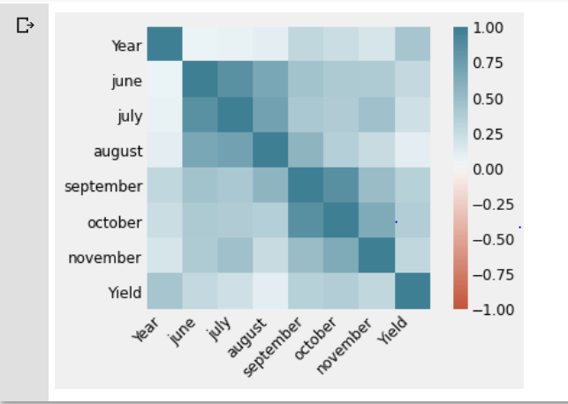
Correlation between Yield and NDVI
ML

Slide 6
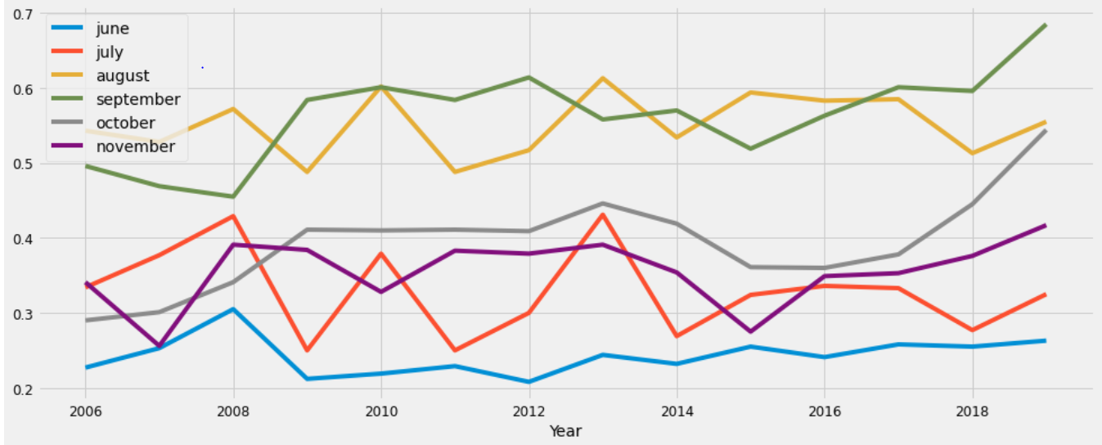
ML
Variation of NDVI for a particular Crop Cycle

Slide 7
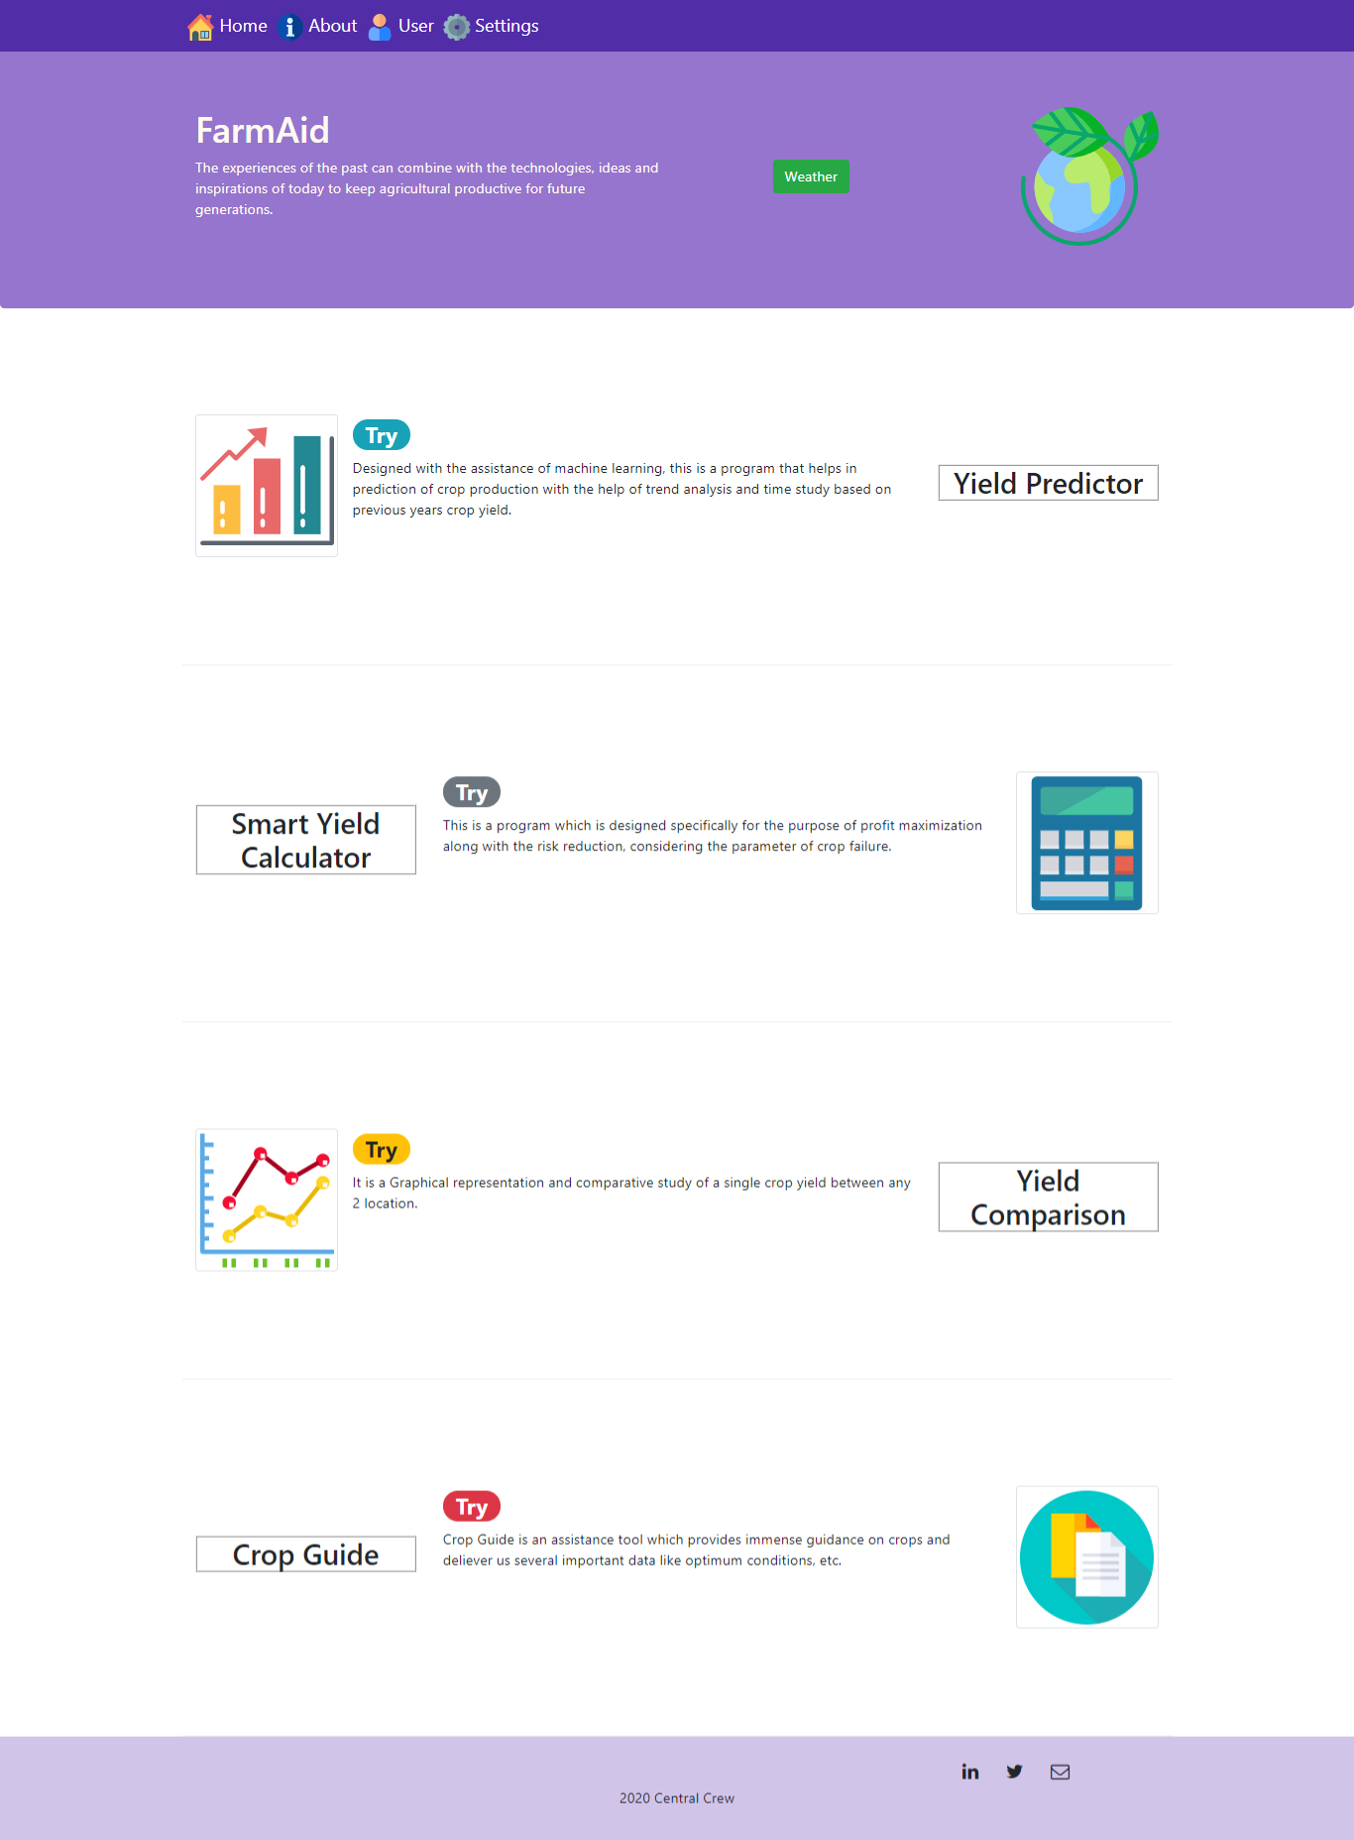
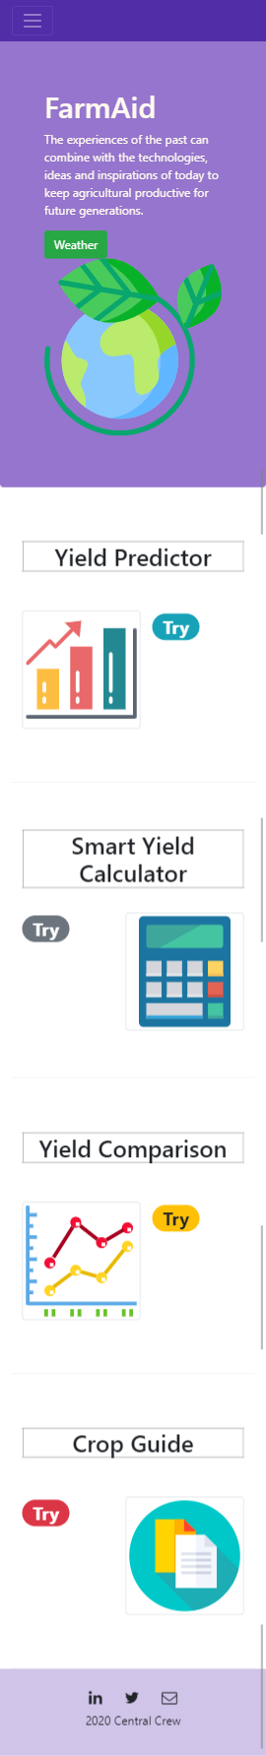
Website
Web
version Interface
Mobile version Interface

Slide 8
How our plan is helping ?
- Automate the process of monitoring of crop production.
Could economise government’s resources.
Aids in the supply chain and management of agricultural resources.
Assists the Govt. in developing a procurement plan for crop production.
Could allocate resources for crop production in a relatively better and
organized way due to an available model provided by our project.

